Slide 1
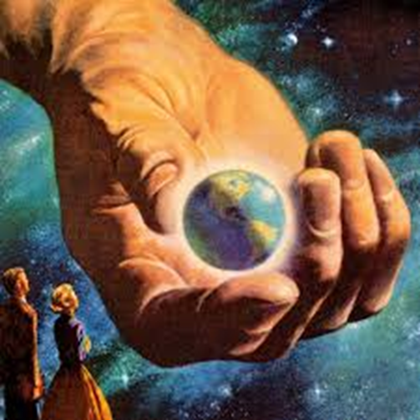
Learning Intentions: Today we are continuing our learning about the cosmological argument which supports the belief in God.
Success criteria: By the end of the lesson you will be able to:
. Understand Aquinas argument in depth.
Can you link this image to our learning?

Slide 2
The mandatory content
Existence of God mandatory content.
Does God exist?
. What arguments/theories do religious people use to prove the existence of God?
. What evidence do religious people use to support these arguments/theories?
. What are the strengths and weaknesses of evidence/arguments/theories?
. What arguments/theories do non-religious people use to challenge the existence of God?
. What evidence do non-religious people use to support these arguments/theories?
. What are the strengths and weaknesses of evidence/arguments/theories?
. Can either religious or non-religious arguments/theories provide conclusive proof about the existence of God?

Slide 3
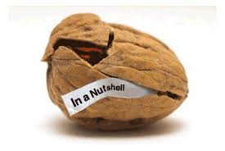
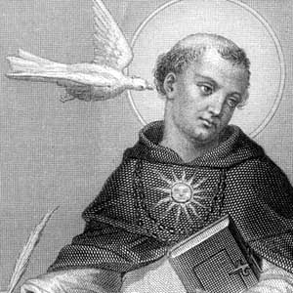
Aquinas argued that every effect must have a cause and that string of effects must have started somewhere. KU
If you track things back through a series of causes, there must have been a 'first cause’. KU
He said that this 'first cause' is God, whom he described as a 'necessary being‘ or ‘the uncaused cause’ who exists outside of our space and time but is able to act within it, needing no explanation and having no cause. KU

Slide 4

“There must be a ‘first cause’. The cause which does not itself require a further cause, I shall describe as ‘GOD’.” (KU)
by the way.
In his work “Summa Theologica” he set out Five Ways of proving God’s existence from this evidence.
These proofs were concerned with the things people observed and experienced every day.
He was very well respected and thought of by theists, atheists and philosophers alike.

Slide 5
1. Everything has a cause.
2. Something cannot have its own cause.
3. A chain of causes cannot be infinite.
4. There must be a first cause.
5. God is the first cause.
https://www.youtube.com/watch?v=lJH18VqdttY

Slide 6
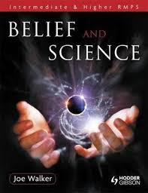
Text book. Page 88
Lets read more about Aquinas

Slide 7
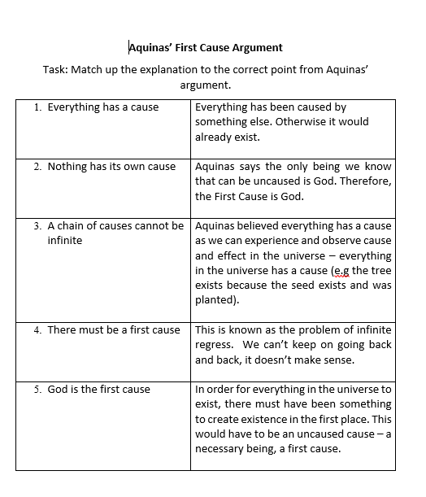
Match up the correct definitions to the correct points.
Summarise the 5 key points in your own words.

Slide 8
Read the following extract from Aquinas’ Third Way:
Assume that at one time there was nothing. It is clear that nothing can come from nothing. If, therefore, there was once nothing, even now there would be nothing. The universe cannot therefore have come into existence from nothing unless something brought it into existence.
However, we know that the universe now exists. If God, or something equivalent in terms of power, does not exist then the universe must always have existed since, if it was not created, it could not have come into existence of its own accord from nothing.
Try to explain what Aquinas was trying to say.

Slide 9

Task
Imagine you were explaining this argument to a 1st year.
You have to try and convince them that God exists, using the first cause argument.
Think about examples that you could use to make it simple.
They must be able to explain:
. The idea of cause and effect.
. What Infinite regress means and how it fits into this argument.
. This concept of God as the first cause/prime mover/ necessary being.
Lets actually do this!

